Slide 1

How to welcome newly arrived children to school

Slide 2
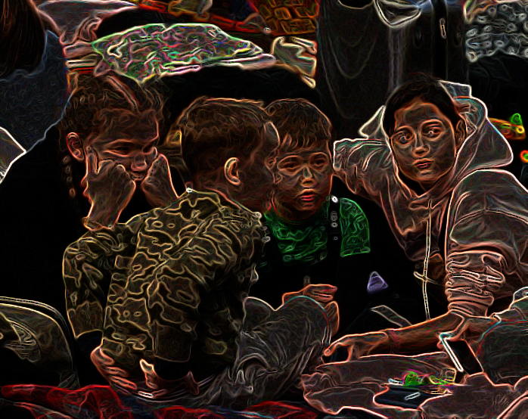
First step: preparing yourself!
The widespread concern about a worrying international situation and the distress of millions of people fleeing is a challenging situation. It requires from teachers an effort for which they are not necessarily well prepared.
An extraordinary situation needs extraordinary solutions: be creative and flexible, use all possible opportunities to take initiatives in your school.
Keep in mind what is manageable for you – it’s important to limit your own stress and to ask for support.
https://www.derstandard.at/story/2000133816302/unicef-sprecher-viele-kinder-stecken-in-der-ukraine-fest

Slide 3

Easing a state of emergency
These experiences trigger rupture, loss, insecurity that can cause severe traumas
3 stages of trauma: leaving home, on the journey,, arriving in a new place
The decisive factor in trauma education is the attitude towards affected children and young people:
  Appreciate and respect what they have achieved in order to survive, including in the case of behavioural problems!
  Enjoy working with these children!
Concept of “good reason”: show understanding and normalise their reaction/their feelings due the stress. (“There is good reason you feel the way you do, this is normal!”)
Notes:
The decisive factor in trauma education work is the attitude. It is about the attitude, how we approach the work with these children and young people, about the attitude towards the children and young people - how do we meet them?
Behavioural challenges
: (e.g. withdrawing, hitting or simply not saying anything anymore)

Slide 4
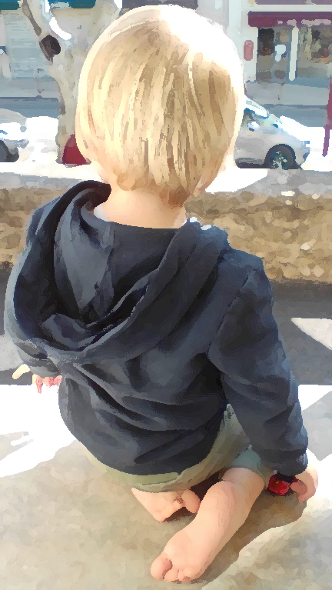
Giving children time to settle in their new school
The most important tasks of the school:
It welcomes the children together with their “backpack”, which contains not only painful experiences, but also many resources and memories
It enables new, positive experiences that counteract the traumatic experiences
All school staff provide protection, external security and good care
Caregivers should as much as possible be protected too: dialogue, supervision, work in multi-professional teams

Slide 5
Recommendations for schools
The school has a strong institutional power: minimise the imbalance between those who help and those who need help
Give a voice to parents and children
  Talk to parents: important to relieve them and to learn more about their children. Keep school pressure low!
  Age/level-appropriate school placement should not be an immediate priority: the well-being of the child comes first
  Provide opportunities for refugee children to spend time together in school, even if they are not in the same class. Don’t split them up totally in different classes – at least not the whole day

Slide 6

Providing a safe place
Teachers are part of the safe place
They provide stability and security
  Teachers stand for reliability, secure relationship and transparency
  Teachers bring fun and enjoyment to everyday school life, reduce time pressure
  Teachers create an environment where children experience self-efficacy and participation
  Teachers ensure appropriate, individually adapted responses to newly arrived children

Slide 7
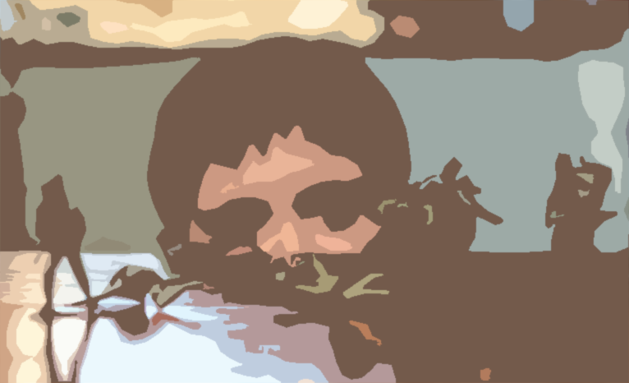
Reassuring all children
https://www.francebleu.fr/emissions/c-est-deja-demain/comment-expliquer-la-guerre-en-ukraine-aux-enfants
Teachers remain responsible for all children
Teachers talk about war and refugees in a child-friendly way
Teachers promote social cohesion and democracy: they involve and support all children in the classroom

Slide 8
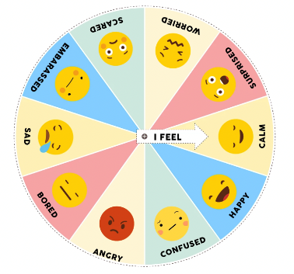
Early days – Don‘t worry if children remain silent!
Language comes second!
Let them express and interpret their feelings with pictures (e.g. emotion wheel or feeling cards)
Allow time for the first words to be spoken
Use other modes of expression and communication (gestures, mimics, dance, drawing, music)
Be mindful and aware that some activities might re-trigger trauma
https://www.mentallyhealthyschools.org.uk/resources/emotion-wheel-for-children/

Slide 9
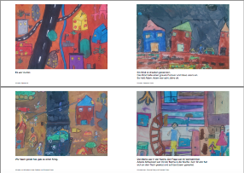
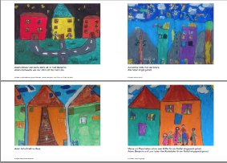
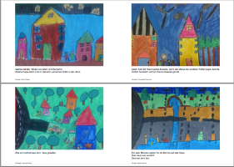
The way to Freedom
Der Weg zur Freiheit
Before talking about fleeing, wait until the child wants to do it!
“The way to Freedom" is based on the story of a child who had to flee his country and found a new home in Austria.
Sahar Sönser, Vienna, 2020
https://www.bildung-wien.at/home/aktuelles/29
https://www.bildung-wien.at/media/file/1758_WegzFreiheit_mittel.pdf

Slide 10
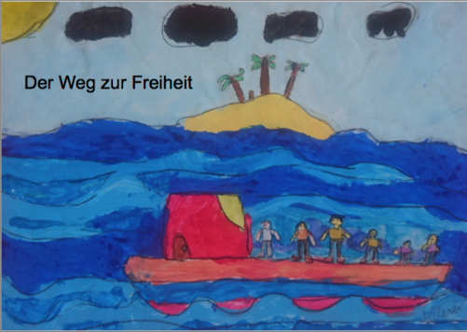
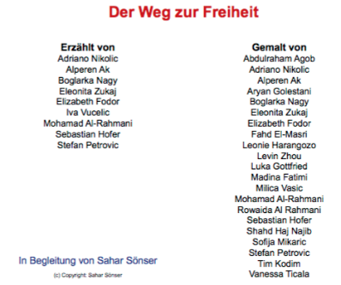
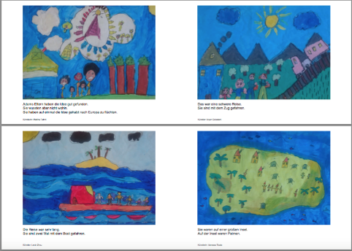
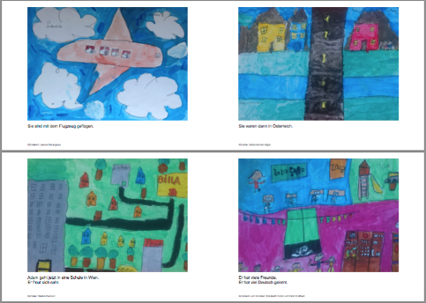
Notes:
Kid hat gestaltet, andere Kinder haben ihm ihre deutsche Stimme geliehen

Slide 11
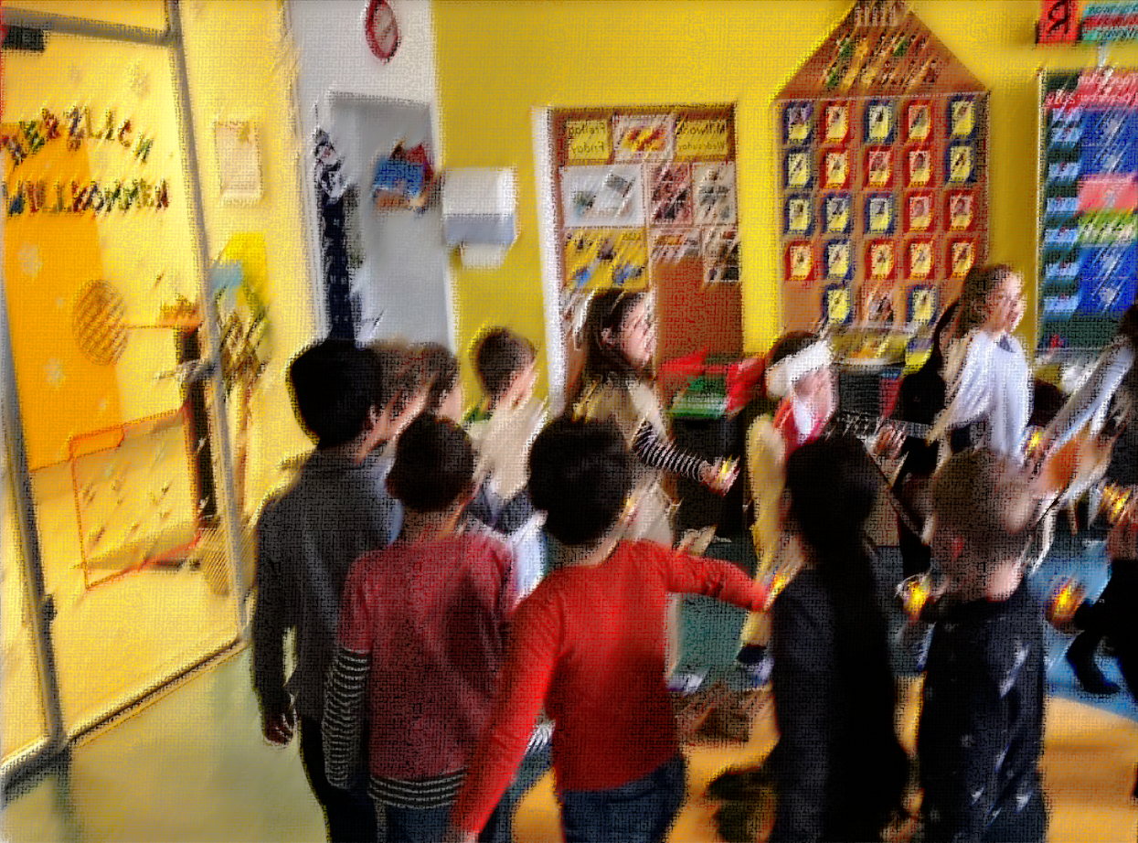
How to welcome children who do not speak the language of the school in your classroom

Slide 12
Some principles
All teachers in all subjects are concerned!
Inclusive approaches:
  Observe the children, use positive (body) language, smile and praise
  Take account of individual learning needs and offer students a choice of task
  Develop a range of techniques for formative assessment
Relate the learning to everyday life
Draw on the entire linguistic repertoire of the children

Slide 13
Welcoming the children in the school and in the classroom
Let the children discover the school building first
Use visual aids for orientation, for school vocabulary and useful words in the classroom: provide posters and markings in the school (pictures, pictograms, symbols, bi- or multilingual labels)
Learn to pronounce the names of newly-arrived pupils properly
Create a buddy system
Introduce rituals using all languages present in the classroom (greeting, starting the day, celebrating a birthday, telling the date of the day, the weather, saying goodbye)

Slide 14
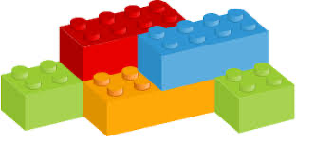
Discovering a new language: starting with useful words
Clarify all available tools used in the classroom
Explain classroom instructions slowly and simply using visual aids
Repeat important words/phrases often: remember them as "chunks"

Slide 15
The role of family language
Possible return to home country: online offers of the Ukrainian education system to assure continuity and facilitate transition
3 statements based on the findings of international educational research on effective classroom practice in multilingual contexts:
  Students learn best in the language they know best.
  Teachers teach most effectively in the language they’re most familiar with.
  The longer teaching and learning take place in the first language, the better the educational outcomes.
Give a place to family languages: they are essential!

Slide 16
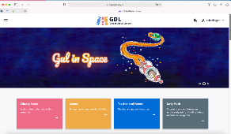
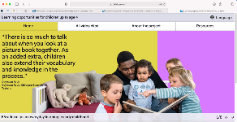
Parents are important educational partners
Parents can help their children to further develop their home language and learn with additional school materials from their country
Children can give their parents the opportunity to learn the new language with them
Provide children with books in family language and involve parents, also in classroom activities
Global Digital Library: https://digitallibrary.io/
Early language learning: Resources for parents https://www.children-4.ch/start

Slide 17
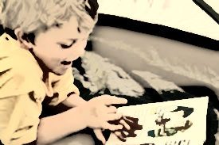
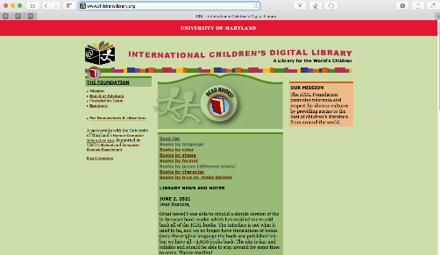
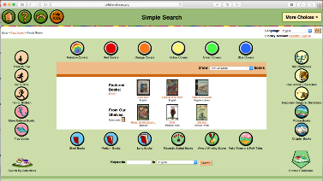
Multilingual Literacies
So many books in so many languages...
ICDL, University of Maryland, USA
http://www.childrenslibrary.org
Notes:
http://maledive.ecml.at/Studymaterials/School/Buildingonplurilingualism/tabid/3619/language/de-DE/Default.aspx

Slide 18
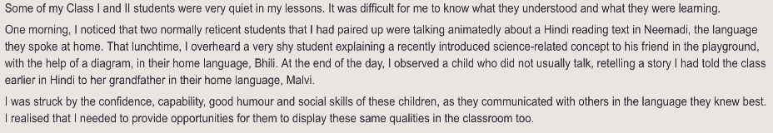
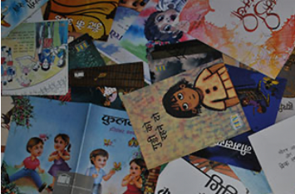
A multilingual classroom: getting started
Teachers‘ attitude matters!
A rural school in Madhya Pradesh,Indien
Multilingual practices in the classroom: greetings, word wall, labels (e.g. features of the classroom), alphabet chart, reading materials, dictionaries, …
See TI-AIE: Multilingualism in the classroom: https://www.open.edu/openlearncreate/mod/oucontent/view.php?id=64814&printable=1

Slide 19
Using all the child‘s languages for learning
They create bridges for communication and learning at school
You can do this by:
  translating between languages
  comparing and being playful with different languages
  mixing words and expressions from different languages in the same spoken or written utterance; text, activity, ...
  using the home language in one part of an activity and the school language in another part
Such a pedagogical approach is called - translanguaging

Slide 20
Why translanguaging?
Supports students in the development of complex content and texts
Supports students in expanding their entire language repertoire
Gives space to multilingualism and the "ways of knowing" of the students
Supports the socio-emotional development and the formation of positive multilingual identities (García/Johnson/Seltzer 2017, xiii).

Slide 21

How to prepare to include chlidren‘s resources and knowledge in all learning

Slide 22
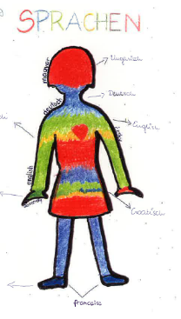
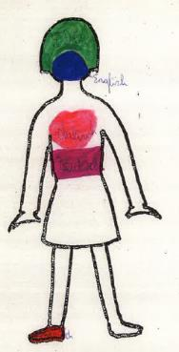
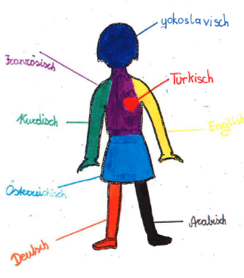
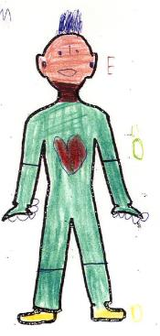
Getting to know our learners
(Quelle: Krumm 2001)
Notes:
Wichtig: Wohlfühlen von Beginn an. It is important to get to know each other. And if we do so we have to take into account the languages that the learners bring with them. One possibility is to visualize the language repertoire. The activity… Hier erläutern, wie der Auftrag lautet
Wenn sie von mir hören, deie Sprache tut nichts zur Sache, dann ist das extrem demotivierend.

Slide 23
Getting to know our learners
Ferenc, 12 years
My heart is Hungarian. The most important parts of my body are Hungarian. My belly is Italian because I like to eat Italian. My legs are German because I live in the German-speaking area ...
(Krumm 2001: 89)
Ebi from Iran, 10 Jahre
English has green color because it always rains there. Arabic has brown color because Arabic countries have many deserts. German has black color because German is hard. Persian has blue color because there are beautiful skies.
(Krumm 2001: 75)

Slide 24
Importance of the first language(s)
In plurilingual classes no one is truly monolingual. Many languages come together: There are different first languages, the language of schooling (as L1/L2), dialects and foreign languages.
With our languages we associate emotions, memories, people. They are a part of our biography.
In many cases we have a language of the heart; often it is the first one we learned. “To reject a child’s language in the school is to reject the child.”
(Jim Cummins 2001, 20)
A child may not speak the language of schooling, but he or she has knowledge of other languages and experience in language learning! These competences are a resource for any further language learning.
The L1 is particularly important, both from an emotional and a cognitive perspective.
Therefore, it is important to make them visible, to value them (STEP 1) and to use them for language learning processes (STEP 2).

Slide 25
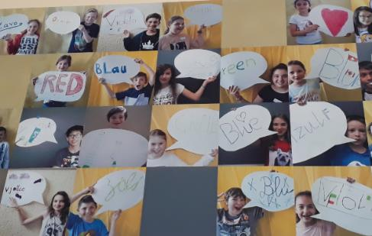
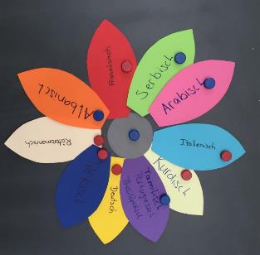
Step 1: Make the languages of the learners visible and value them
Project MALEDIVE
Many examples of how to visualise language repertoires, how to experience a new language in a „cool“ way or how to deepen reflection.

Slide 26
Step 2: Use the languages of the learners
Children learn quickly. But they make mistakes. This is completely normal and no cause for concern. What is important is a positive error culture (e.g. corrective feedback).
Mistakes have didactic potential:
    Student 1: Give me pencil.
    Student 2: That's not how you say it.
    Student 1: ???
    Pupil 2: It means: Give me pencil please. (Dirim & Müller 2007: 6)
Depending on the first language, the errors can differ. Knowledge of this creates understanding and allows for individual support measures.
Notes:
Nach einer Woche nicken sie oder schütteln den Kopf. Nach vier Wochen antworten sie. Nach drei Monaten… Aber sie brauchen unsere Hilfe. V.a. beim Erwerb der Schriftsprache. Ich kann gar nichts anders als alles, was ich weiss einbeziehen. Fragen der Kinder zum Thema machen!

Slide 27
Step 2: Use the languages of the learners
In language learning, as in all learning, we inevitably draw on prior knowledge. It is therefore important that children experience how helpful it is to compare the different languages they have in their heads.
Multilinguals often have already developed language awareness. It is important to make use of this.
When I say “Katze“ [German word for “cat”] in Greek,
it means "sit down."
Teachers do not need to know the languages of the learners. But they do need knowledge about similarities and differences between the learners' languages and the school language.
The better a child knows his or her (first) language, the better he or she can use it for further language learning. It is important that the first language is cultivated in the family context.

Slide 28
Step 2: Use the languages of the learners for language learning processes
Project MALEDIVE: https://maledive.ecml.at/Studymaterials/tabid/3623/language/en-GB/Default.aspx
A lot of material about how to
assess language competences
scaffold
build on plurilingualism
develop collaboration across subjects

Slide 29
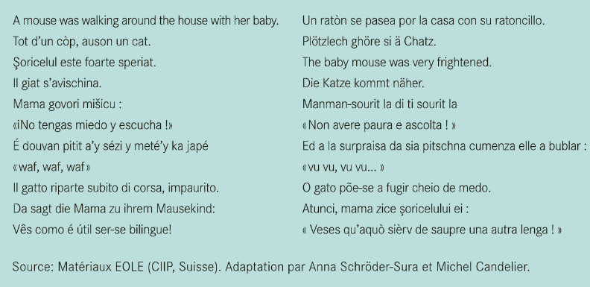
Example:Language comparison
(carap.ecml.at)

Slide 30
Example:Language comparison http://carap.ecml.at/
English translation:
A mouse was walking around the house with her baby.
All of a sudden, they heard a cat.
The baby mouse was very frightened.
The cat came closer.
The mother mouse said to her baby : « Don’t be afraid. Listen! »
And to the young mouse’s greatest surprise, she started barking : « Woof, woof, woof, woof ! »
Now it was the cat’s turn to be scared, and it ran off…
The mother turned to her baby and said :
« See how useful it is to be bilingual! »
What languages did you regonize?

Slide 31
English | Spanish
Occitan | Swiss German
Romanian | English
Romansch | German
Serbo-Croatian | Guadeloupean creole
Spanish | Italian
Guadeloupean creole | Romansch
Italian | Portuguese
German | Romanian
Portuguese | Occitan

Slide 32

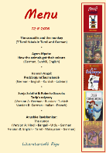
The first language can be used for…
Alphabetisation
  If a child does not (yet) speak the school language, he or she can learn the alphabet through the first language.
  Knowledge of writing systems is helpful (do the signs stand for sounds, syllables or words?).
Knowledge about different types of texts
  Fairy tales have the same structure in every language! This can be experienced through the first language.
  Multilingual reading, e.g. with a "literary menu" together with parents at a school celebration allows collaboration with parents.
app for creating „identity texts“: https://scribjab.com/
(Hsueh 2016)

Slide 33
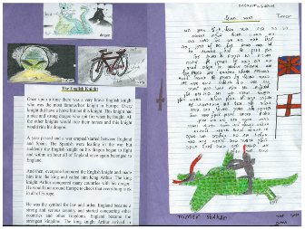
The first language can be used for…
Production of texts
  when planning a text in the school language (or a foreign language), the ideas can be written down in the first language
  "Identity texts" are a creative way to feel one's L1 as a resource, and they reflect one's identity.
  app for creating „identity texts“: https://scribjab.com/
Dr. Sarah Cohen, Loyola University (2014)
http://www.luc.edu/media/lucedu/education/pdfs/languagematters/Cohen%20-%20.Identity%20Texts.pdf

Slide 34

How to work with all the learners’ languages

Slide 35
Empowerment
Children may not remember what we say but they will always remember how we made them feel
Our attitude shows through our body language
– show the the child that she/he is priority; she/he is valued; she/he is safe
People fleeing war may not want photos of themselves or their children to be taken but they may feel afraid to say no. Empower those we seek to help – How can we help you? What can we do for you?
Establishing peace is the work of education. All politics can do is keep us out of war Maria Montessori

Slide 36
Including everybody’s language using
ECML resources

Slide 37
ECML: Inspiring Language Learning in the
Early Years (ILLEY)
The adaptability of ILLEY to the various contexts in which learning and teaching take place lies in its child-centred approach
Build on what the children know
The focus is on encouraging the use of what the child brings to the learning situation, even when this is in a language not known by the teacher
Whatever the language, wherever it is being learned, the ideas presented in ILLEY can be applied in schools and classrooms throughout Europe and beyond

Slide 38
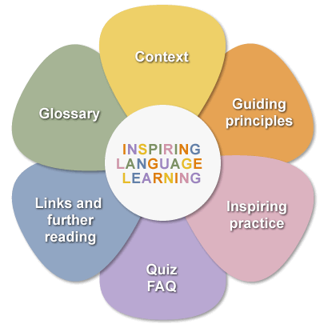
ILLEY

Slide 39
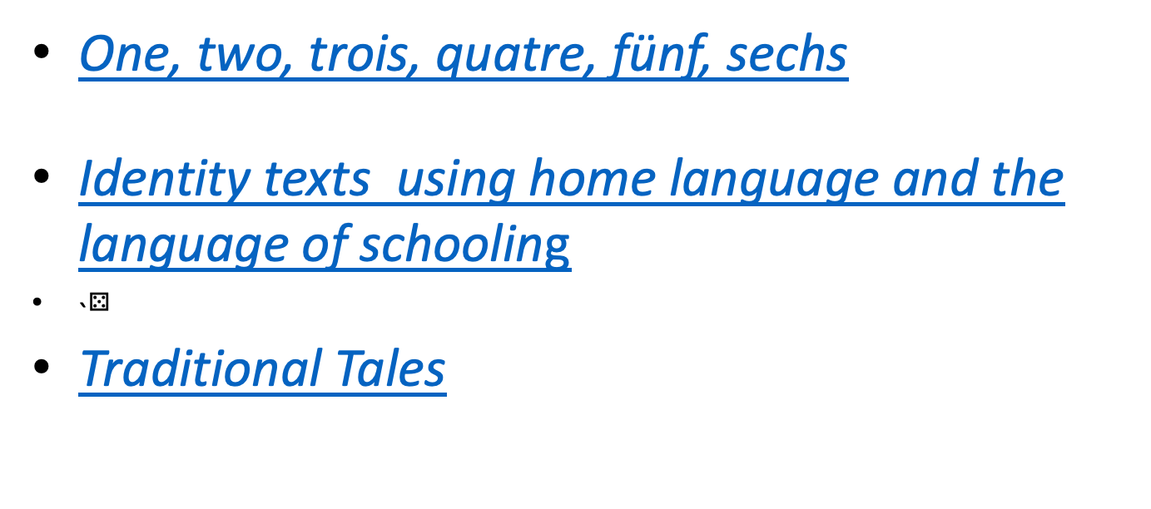
ILLEY links (age 3 to 6)
One, two, trois, quatre, fünf, sechs
Identity texts using home language and the language of schooling
˴$⚄$
Traditional Tales

Slide 40
ILLEY links to written work
(age 6 to 9)
In the park (three languages: age 8)
The clue is in the word!
Diary

Slide 41
ILLEY links (age 9 to 12)
Plurilingual Fashion Show (four languages age 12)
Madame – a story in English using French words

Slide 42
Links to books – ILLEY
Books without text
Multilingual books

Slide 43
ECML Treasure Chest of Resources for learners, parents and teachers
The Treasure Chest supports learning that is:
Learner-centred, motivating and fun for everyone involved
Develops learners’ plurilingual repertoires – language of schooling, foreign languages and children’s home languages
Supports young people’s wellbeing in difficult situations
Gives parents/carers confidence in supporting their children’s learning
Includes self-management tools to develop learner autonomy and track progress
Link to webinar: https://www.youtube.com/watch?v=ZAEZO_zPQVc

Slide 44
Supporting Wellbeing
Sink and float
Playing with water is a very calming activity for children
What you need:
What to do:
Some more ideas

Slide 45
Sink and float
Image of object
Home Language
Metal key
Plastic spoon
Stone
Etc.
Language of Schooling

Slide 46
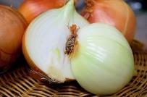
Get Growing!
PLANT seeds!
Lettuce/scallions/ beetroot/ pumpkins/
wallflowers/ nasturtiums /primroses, etc.
WRITE - Labels for seeds planted in the garden/ pots on your windowsill
Do it in your Home Language. In another column write it in the Language of Schooling/ another language
Grow your own onions!
What you need…
What to do…
Some more ideas…

Slide 47
Get Growing!
Home Language | Language of schooling
Lettuce
Beetroot
Primroses
Etc.

Slide 48

Go outside!
My book of trees
You can make your own book of the trees in your neighbourhood
Find out their names, make rubbings of their bark and draw their leaves, flowers and fruit
Your book will help you to remember the names of the trees and the shapes of the leaves
More ideas about this in the Treasure Chest. How to do it! ECML Treasure Chest of Resources for learners, parents and teachers
Use your Home Language followed by Language of Schooling and other languages where appropriate

Slide 49
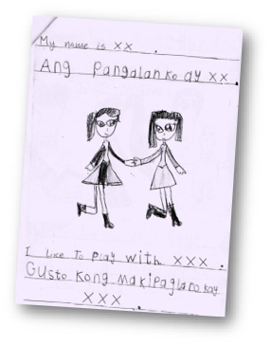
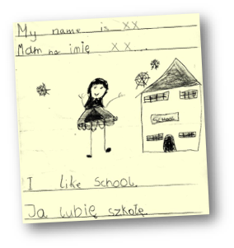
Make a book about me
Home languages;
Language of schooling;
and other
languages too

Slide 50
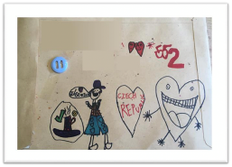
Keeping in contact with those we love: talking on the phone and writing letters
Dear Grandma, dear Grandpa
Writing a letter can be strongly motivating
as it is a means of getting in touch with those we miss. This activity supports the child’s sense of belonging and develops his/her communication and writing skills.

Slide 51
Home languages help with learning in school
Knowing their home language will help children to:
Have confidence in who they are. Confidence is very important for success in learning and in life
Remain connected to their wider family, e.g., grandparents, cousins
Develop skills like observation, analysis, reflection, questioning, exploration – all very necessary for learning
Transfer skills from hoe language to learning the language of schooling, additional languages, and subjects like Maths and Science as well.
Be interested and motivated to learn
Develop independent/autonomous learning skills

Slide 52

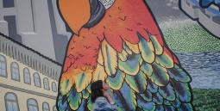
Treasure Chest – Reading
DISTANCE LEARNING: FREE DIGITAL READING RESOURCES FOR MULTILINGUAL LEARNERS
POBBLE 365 – AN IMAGE A DAY
Multilingual reading resources are designed to help
multilingual learners with their reading skills. Books and
stories in a wide variety of languages give you the opportunity
to explore new places, meet new characters and discover
new languages.
Language of the website: English
Resources: wide variety of global languages
Age range: all ages
This website provides a new weird,
wonderful or thought-provoking
image for each day of the year to
inspire children to write a creative
story.
Age range: 9+

Slide 53
Free to Access
Little, D. & D. Kirwan (2021) Language and Languages in the Primary School: Some guidelines for teachers. PPLI
https://ppli.ie/teaching-and-learning/supporting-multilingual-classrooms/?gresource=ppli-primary-guidelines/

Slide 54

How to support learning in all subjects

Slide 55
Promoting successful education
It is a core mission of schools to support the learning processes of each child and young person in all subjects: Language plays a key role in this
All learners have to develop academic language skills in all subjects: for newly arrived children and young people this is a very challenging situation
Each subject has specific language requirements related to cognitive tasks: for teachers a matter of awareness and know-how
Many language skills are transferable from one language to another: using stronger languages to learn helps!

Slide 56
Teaching and learning need language(s) in all subjects
“How do I know you know until I hear what you say, read what you write or see what you show me in an appropriate way?”
Make sense of new content, for example by
    describing and labelling the parts of a cell
    explaining and defining a complex process such as photosynthesis
    comparing different types of volcanoes
    assessing and evaluating the opportunities/threats of hydraulic fracturing (fracking)
Pluriliteracies, ECML project: https://pluriliteracies.ecml.at

Slide 57


Scaffolding: a core teaching competence
Scaffolding is a temporary support that helps learners to become more independent and able to manage learning on their own.
What a learner can do today with support, he or she will be able to do alone tomorrow.
Scaffolding helps all learners!
MALEDIVE: scaffolding
http://maledive.ecml.at/Studymaterials/School/Scaffoldinglearning/tabid/3618/language/en-GB/Default.aspx

Slide 58
Different levels of scaffolding
Macro-scaffolding
(Gibbons 2002, Kniffka 2010)
Micro-scaffolding
(Gibbons 2002, Kniffka 2010)
Needs analysis, e.g. difficulties in a written text
Knowledge and learning abilities analysis (Which linguistic structures can lead to problem in the classroom?)
Planning of teaching lessons (activating pre-knowledge, planning additional activities, organizing working groups, etc.)
Useful words or phrases (wordbanks), model sentences or phrases to be used to complete a task, etc
Teaching interaction in the classroom
Active listening to pupils‘ talk
Repeating, summarizing, gestures
Reformulation of pupils‘ utterances
Explanation/Clarification of vocabulary or expressions appropriated for a specific context

Slide 59
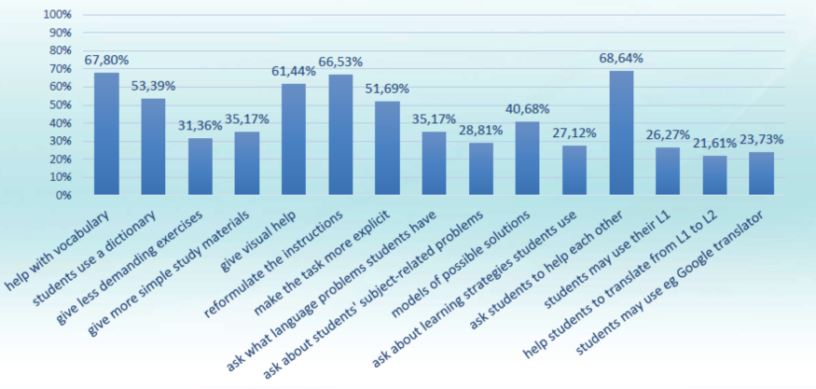
Supporting learning in all subjects
ECML project Language in Subjects

Slide 60
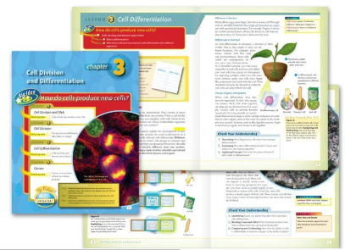
Scaffolding with teaching materials
language
questions, operating instructions
tips and advice for thinking and learning
lists, summaries
visual image, photos
labelled illustrations
titles, subtitles and nuggets
definitions, glossary
colours and boxes
diagrams ans charts
markings in text
...

Slide 61
Some recommendations
Take into consideration what the learners already know about the subject in their first language
First, reduce the language difficulties by providing support: this will allow access to more complex content and deeper learning in the school subject.
Make language explicitly part of subject teaching:
  Encourage your learners to identify language difficulties and ask for support
  Make learners aware of language learning strategies and techniques
  Encourage them to self assess their linguistic skills in your subject.

Slide 62


Further ideas to explore…
SMC-Supporting Multilingual Classrooms : Recommendations for teachers
ECML project Pluriliteracies : Learning materials
ECML project MALEDIVE: Scaffolding
ECML project Language in Subjects
  Check-list for language sensitive teaching
  CEFR linked descriptors for mathematics and history/civics

Slide 63
Multilingual education for a more peaceful world
Taking in refugees, giving them a new chance to regain some stability and to take back ownership of their future is a difficult task.
It is also an ethical issue that concerns us all of us: it is about respecting human rights and democratic values to move towards a more peaceful world.
Beyond the current situation, there are many reasons why many people in the world have to leave their homes.
In this sense, multilingual education is a positive response to our changing world: it should become accessible and benefit all.

Slide 64
Dank je wel
Tak
Paldies
Ačiū!
Благодаря!
Go raibh maith agat
Merci beaucoup
Благодарам
Muito obrigado
Vielen Dank
Mersi
Dziekuie
D´akujem!
þakka
Спасибі
Takk!
Thanks a lot
Շնորհակալություն
pateikties
Kiitos
Ευχαριστω
Tack!
Mille grazie
спасибо
¡Muchas gracias
Hvala
Faleminderit
Grazzi
Tänu
Děkuji

