Slide 1
”Languages at the heart of learning”
ECML Programme 2016-2019

Slide 2
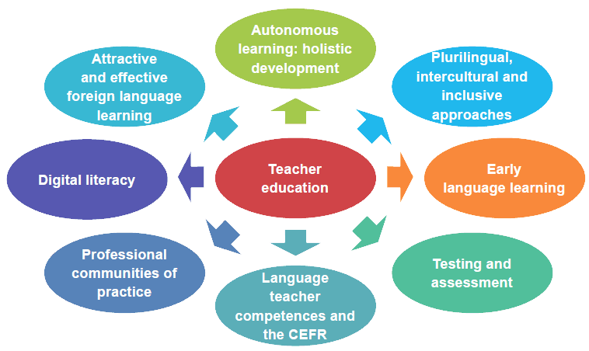
Consultation process
PRIORITIES OF ECML MEMBER STATES

Slide 3
“Languages at the heart of learning”
ECML Programme 2016-2019
Projects
Training and Consultancy
Mediation
Think tanks
Development projects
Part of the Development strand
.
Targeted support to address national challenges
Enhancing the impact of the ECML work
Notes:
·

Slide 4
“Languages at the heart of learning”
ECML Programme 2016-2019
Projects
Training and Consultancy
Mediation conferences; colloquia; national support events; webinars
Think tanks
Professional learning communities
Language teacher competences
Quality assurance and the CEFR
Early language learning
Sign Language Instruction
Whole school support for the languages of schooling
Foreign languages
Languages of schooling
Pathways for learning
Digital literacy
Adult migrants
Teacher education
Plurilingual education
Adult migrants
Mobility
Testing and assessment
Digital literacy
Plurilingual education
Using the e-ELP
Languages in higher education
Multilingual classrooms
Testing and assessment
European Day of Languages
CLIL and pluriliteracies
Supporting Romani
Notes:
·

Slide 5

ECML Programme 2016-2019
Languages at the heart of learning

