Slide 1

The NGT Functional Assessment
assessing sign language levels by means of an interview
Eveline Boers-Visker MEd
Annieck van den Broek MEd
Prof. dr. Beppie van den Bogaerde

Slide 2
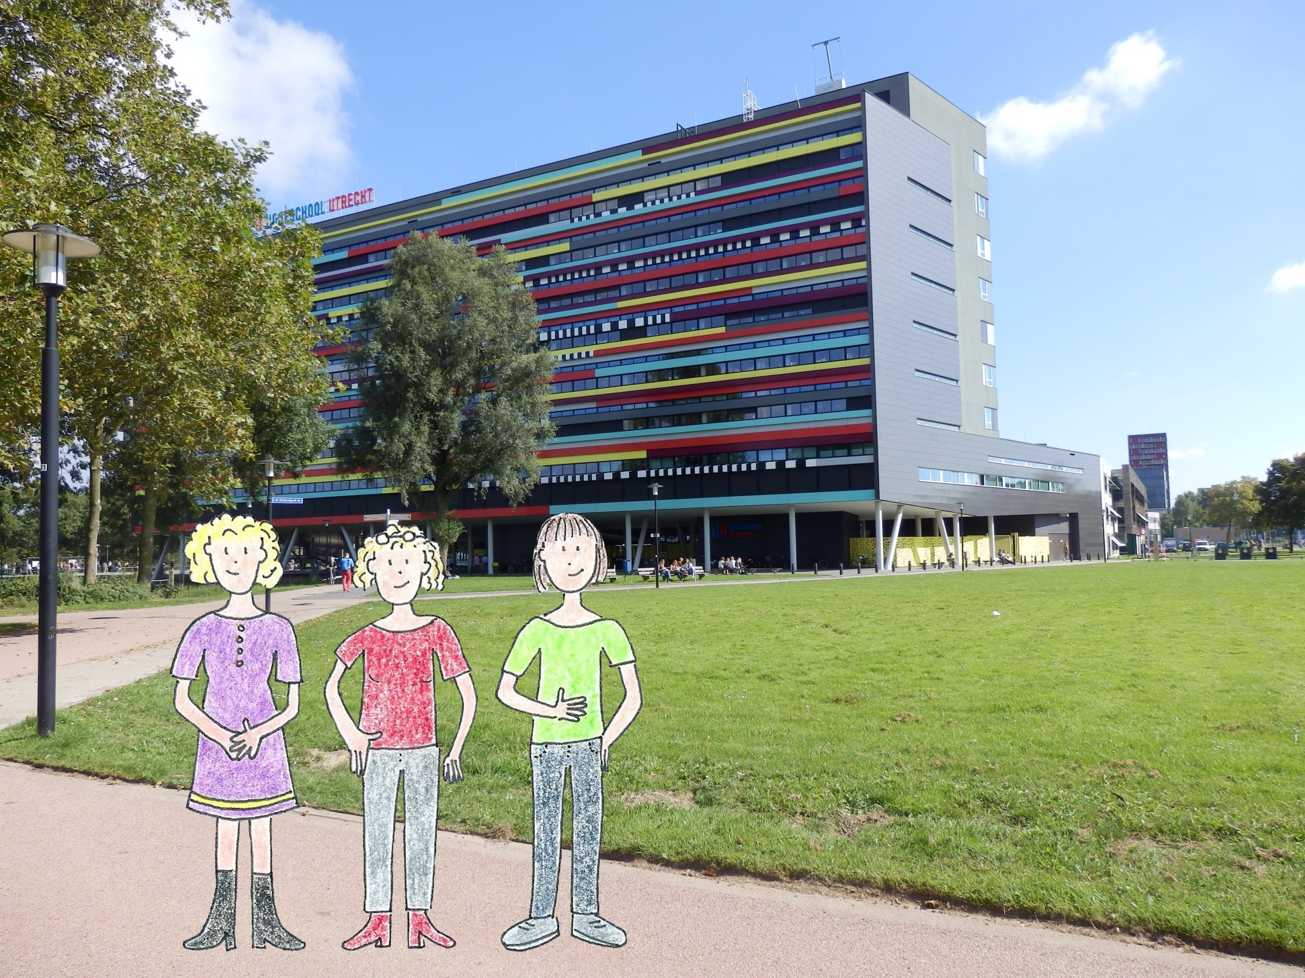
Eveline
Boers
Annieck
van den Broek
Beppie
van den Bogaerde

Slide 3
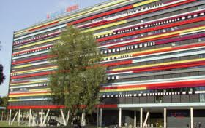




Bachelor Interpreter NGT (4 years)
Bachelor Teacher NGT (4 years)
400 students
Associate Degree speech to text captioning (2 years)
Minor Deaf Culture & NGT (6 months)
100 students

Slide 4
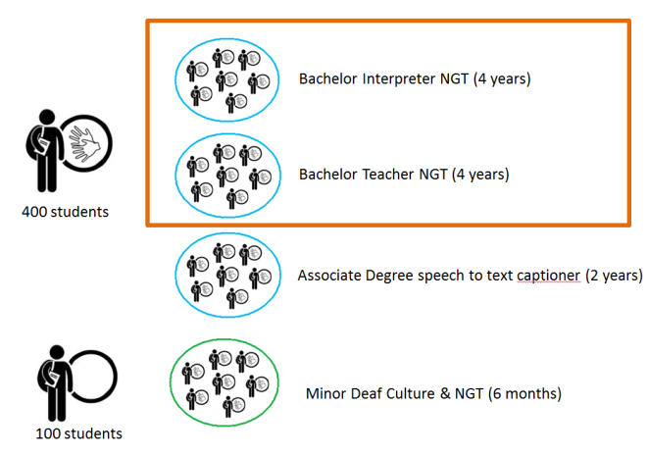
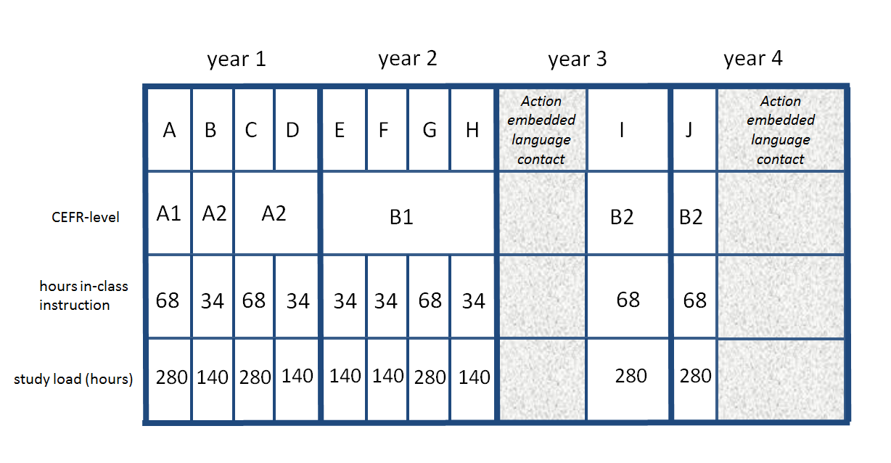

Slide 5
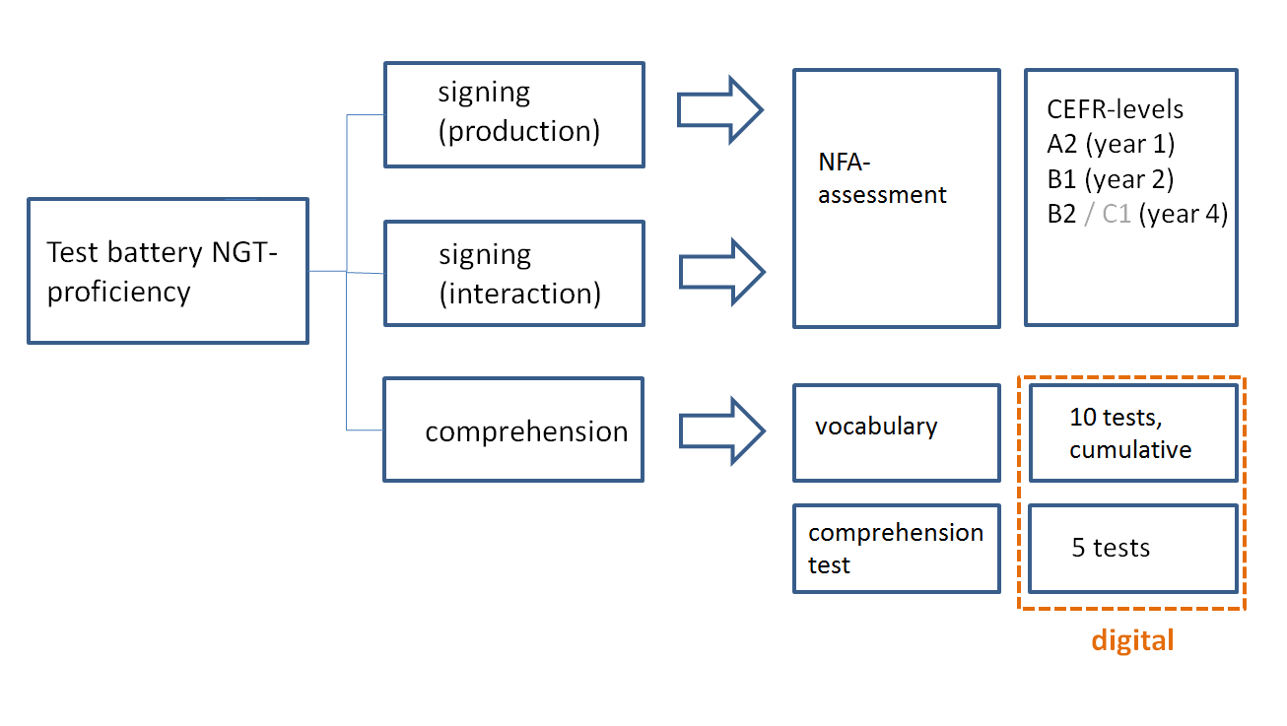

Slide 6
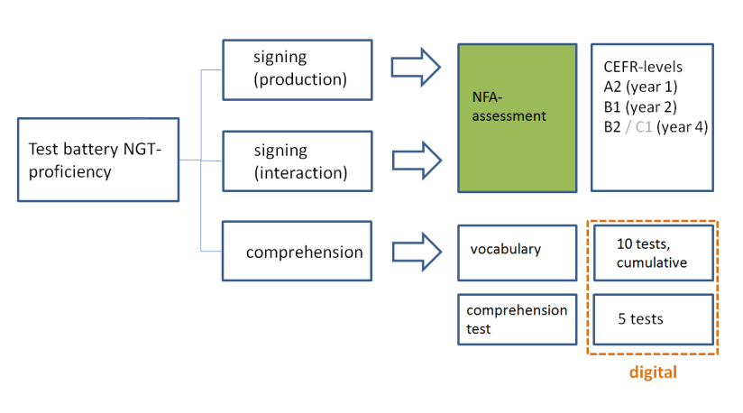
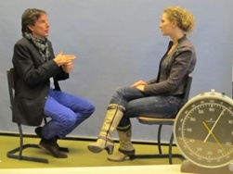
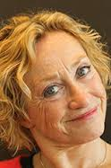
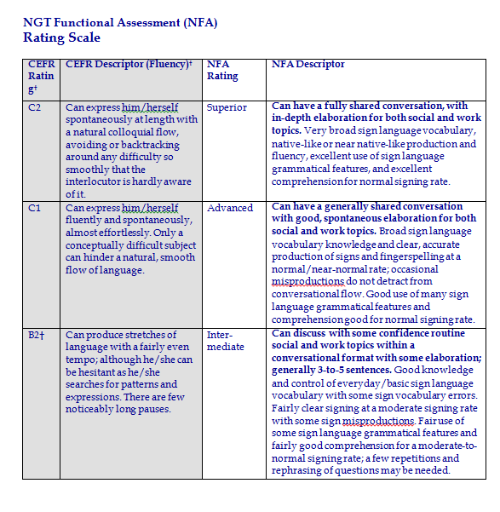
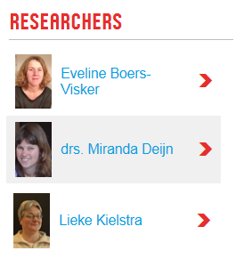



Slide 7
a
training (dec 11)
familiarization
intern training
training (sept 12)
familiarization
intern training
implementing
NFA
adaption SLPI => NFA
①
n = 18 (4th year students)
n = 13 (teachers Deaf school )
n = 23 (parents of deaf children)
④
n=14 (pilot study
1st and 3trd year students)
n= 9 (teachers Deaf school)
②
③
⑤
❻ ❼
interraterreliability-sessions

Slide 8
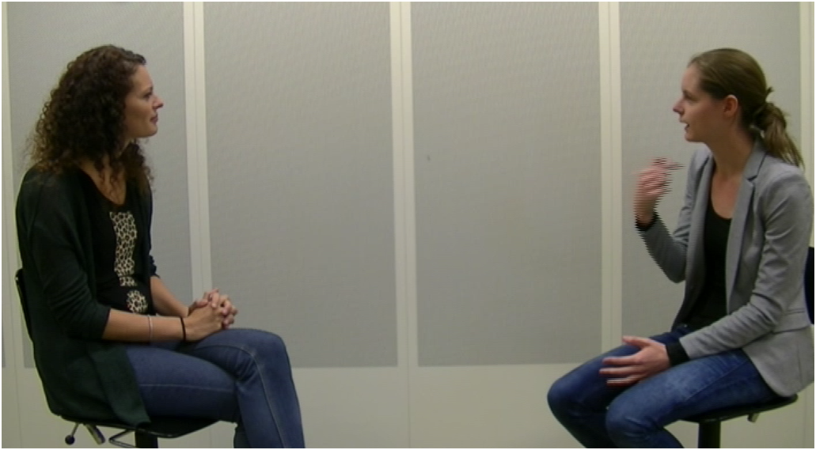

Slide 9
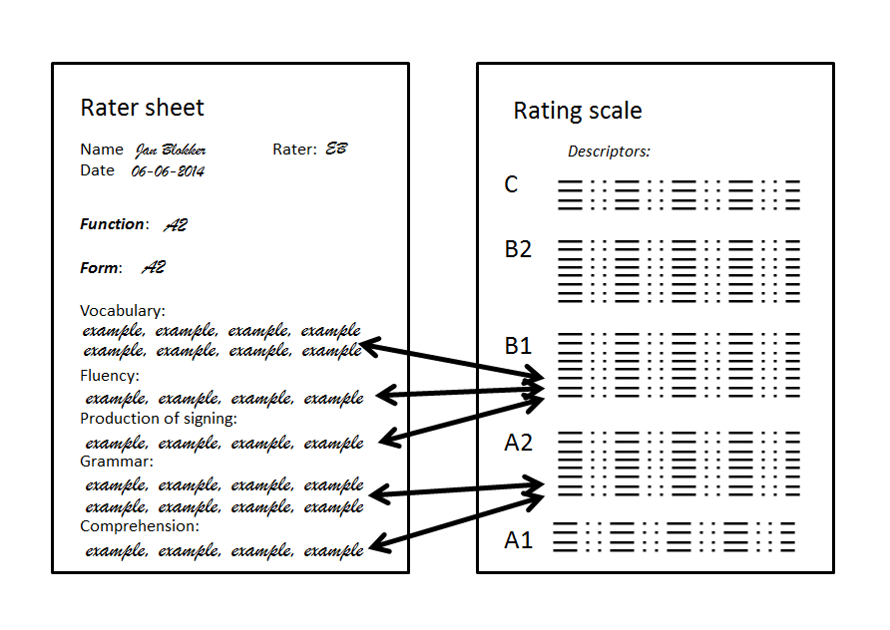

Slide 10
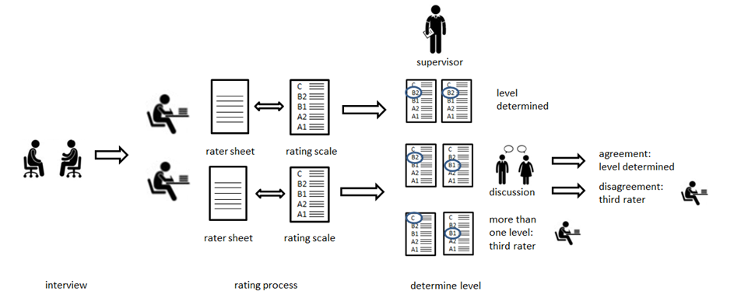

Slide 11
Strengths
Conversation
No influence of written language
Student is pushed to highest level
Two (or more) raters
Raters and interviewers must be certificated
Introvert persons in disadvantage
Positive (what can the student sign)
Weaknesses
Artificial situation
Preparation
Quality interview influences results
Does not cover all areas of language acquisition
Other disadvantages:
Intensive training interviewers and raters
Time-consuming (but: we conduct less tests overall)

Slide 12
College-year
A B C D summer E
nov feb apr jun aug
Time-independent, for formal reasons linked to courses C, H and J

Slide 13
4th year teacher-students [n=16]
4th year interpreter-students [n=37]
8 students awarded B2 (50%) 14 students awarded B2 (38%)
C-levels: deaf students no C-levels

Slide 14
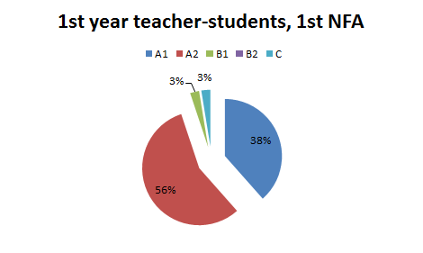
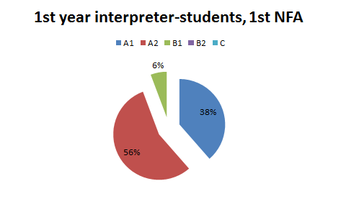
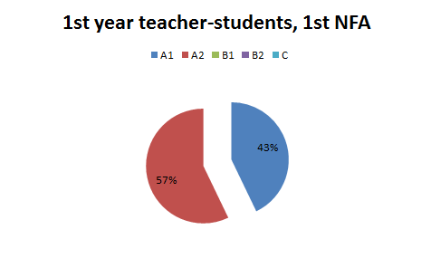

Slide 15
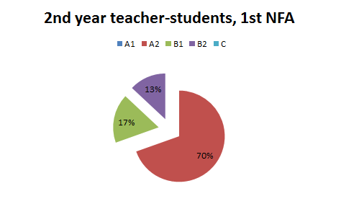
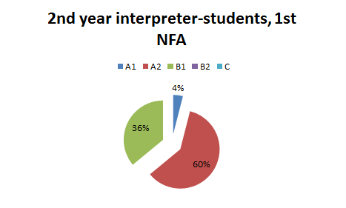

Slide 16


Wake up call!

Slide 17
Inter-rater reliability
n=28 n=16 n=128 n=127 n=28

Slide 19
Inter-rater reliability
n=9 n=2 n=1

Slide 20
Work to do!
Increase inter-rater reliability NFA (85-90%)
Raise levels of students (cohort-study)
Develop summative production tests in addition to test-battery
increase feedback/formative testing
encourage use of self- and peer-assessment through portfolio
Manage workload

Slide 21

Notes:
Question mark: 123RF.com

Slide 22
Acknowledgments
Karin Vinke – NFA-candidate
Marte Bol Raap – NFA-interviewer
Geoffry S. Poor - SLPI/NFA-trainer

Slide 23
Sources
Drawings by Eveline Boers
All illustrations were composed by Eveline Boers; icons: 123RF.com
Questionmark: 123RF.com

